Slide 1
Group 5 (SS6)
By:
Sim Xin Ni Clodia
Nicholas Chin Wei Lun
Tu Xia Yang
Vevek Selvam

Slide 2
Project 2
Dijkstra’s algorithm
Adjacency Matrix + Array Priority Queue
VS
Adjacency List + Min Heap Priority Queue

Slide 3
The Question
Using the Dijkstra’s algorithm, we want to find out how the following affects it’s time complexity:
Input graph representation
Priority queue implementation

Slide 4
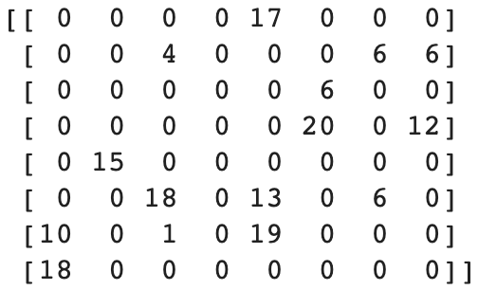
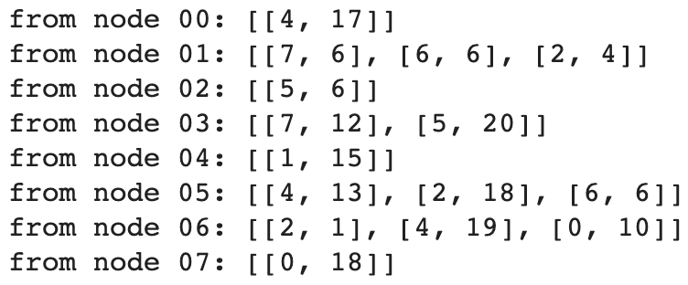
Adjacency matrix vs list
Matrix
List
Notes:
The adjacency list will be all the lists put together

Slide 5
Our hypothesis
We think that the minimising heap would work better than the array for Dijkstra’s algorithm

Slide 6
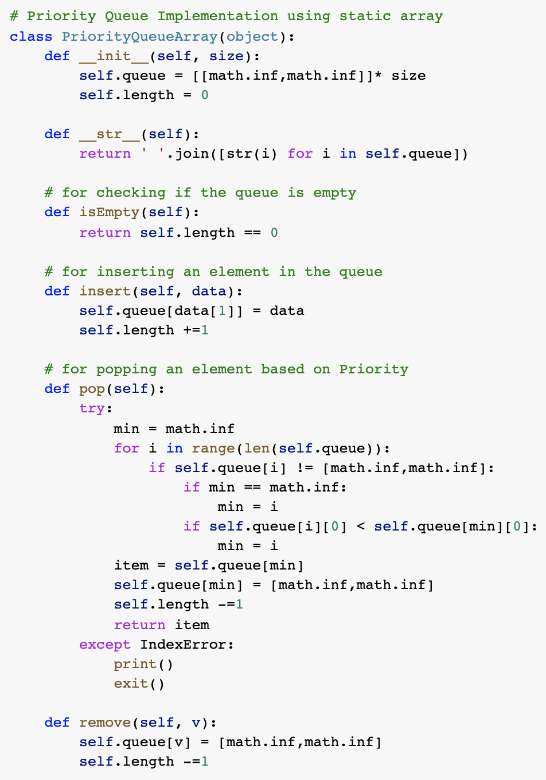
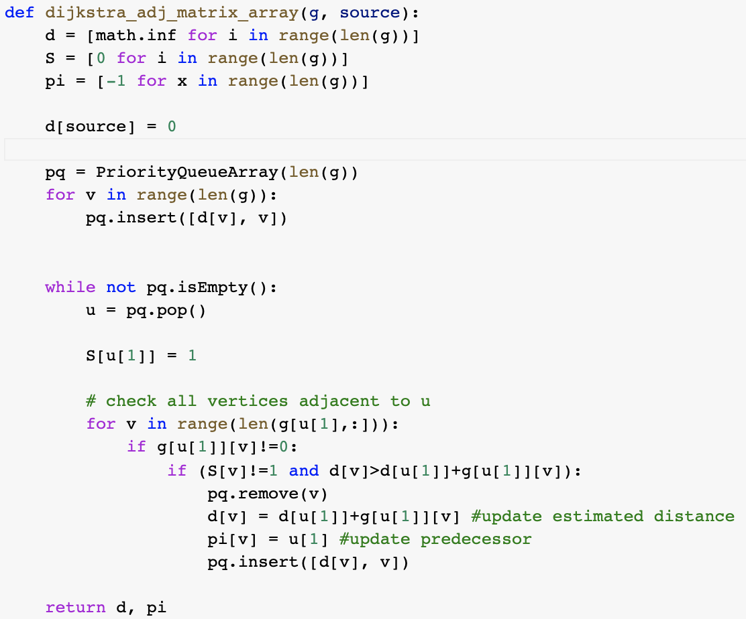
Part a (Adj Matrix with Array Priority Queue)

Slide 7
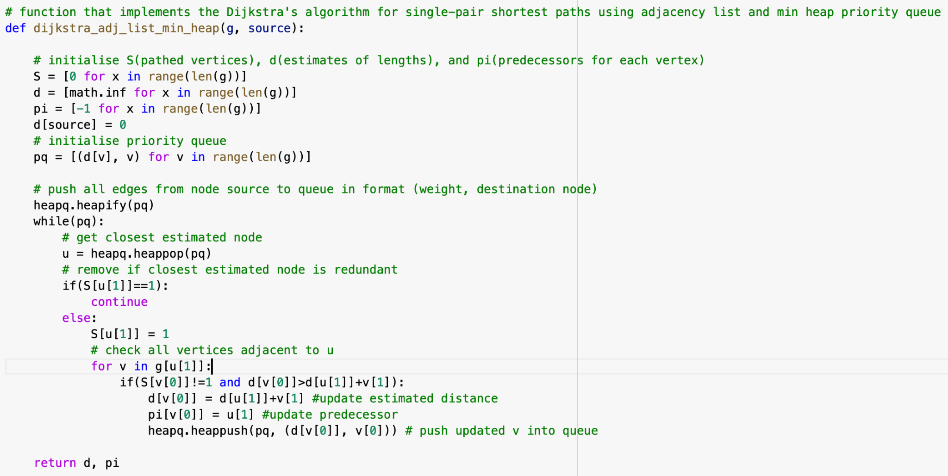
Part b (Adj List with Min Heap)
Using a minimizing heap for the priority queue: (code)

Slide 8
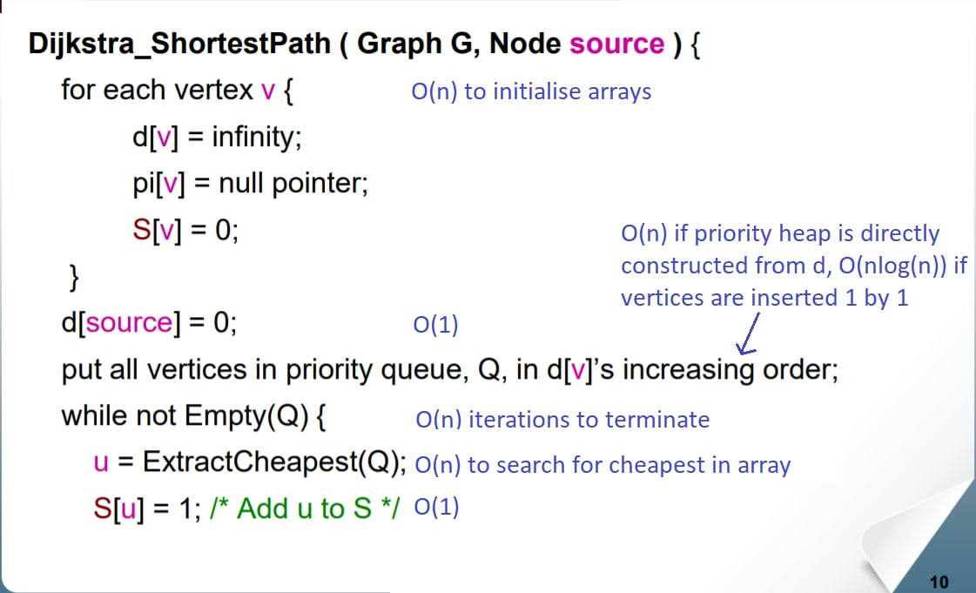
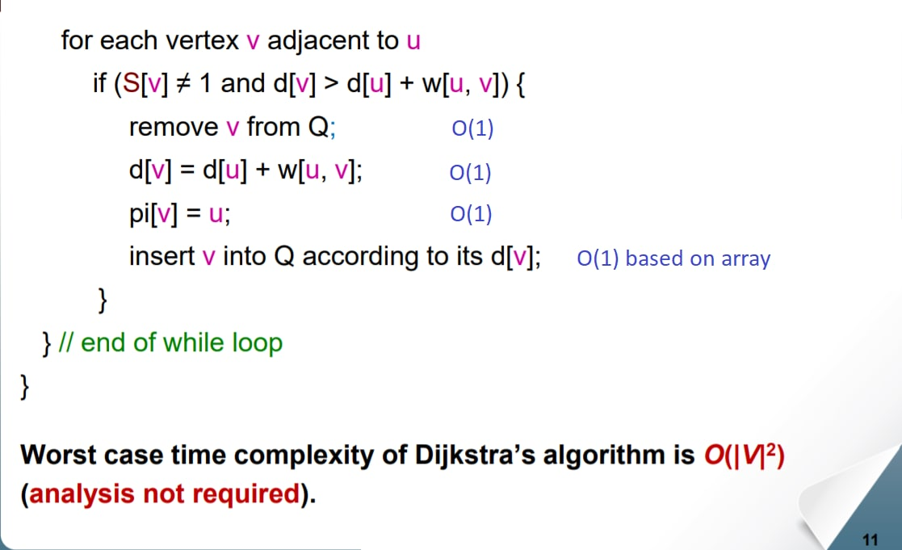
Part a Time complexity (theoretically)

Slide 9
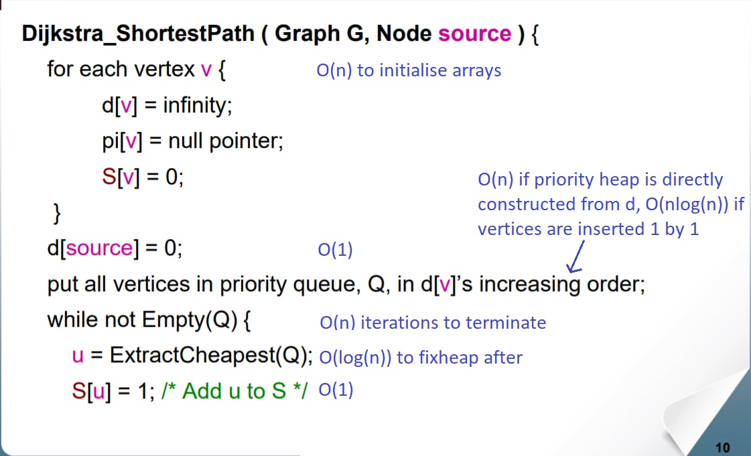
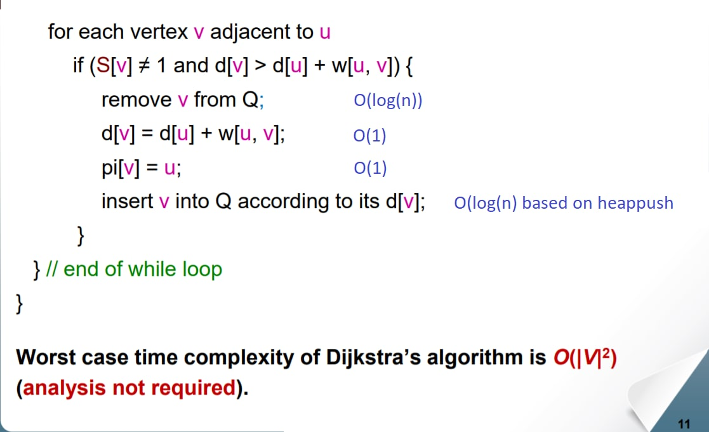
Part b Time complexity (theoretically)

Slide 10
Time complexity (theoretically)
Adjacency Matrix (array): O(V²)
Adjacency List (minimizing heap): O((V+E) logV)
Based on these equations, we can conclude:
For sparse graphs:
Order for adjacency matrix = O(V²)
Order for adjacency list = O((V) logV)
Adjacency list with minimizing heap as priority queue is more efficient
For dense graphs: there will be close to (V(V-1)) edges = V²
Order for adjacency matrix = O(V²)
Order for adjacency list = O((V+E) logV) = O((V+V²)logV) = O((V²)logV)
Adjacency matrix with array as priority queue is more efficient

Slide 11
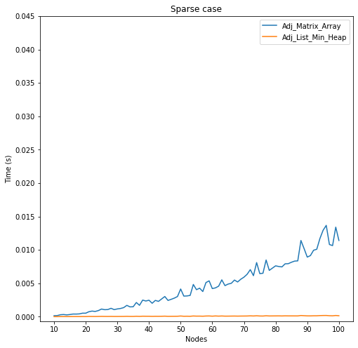
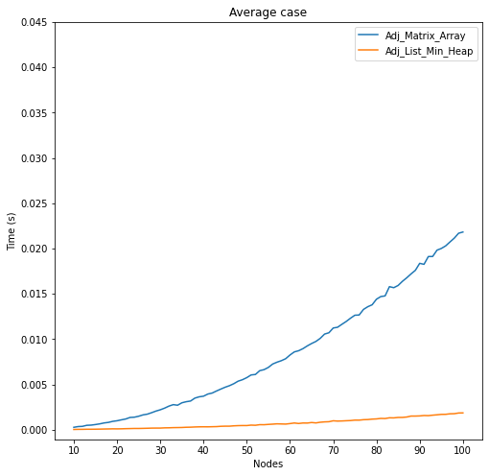
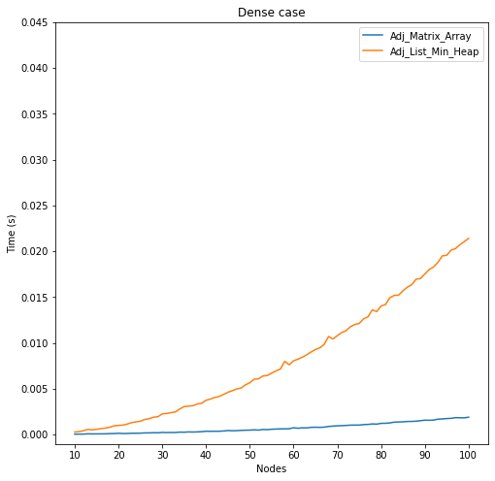
Time complexity (empirically)
Sparse graphs
Average graphs
Dense graphs
(Cpu time graph)

Slide 12
Conclusion
For dense graphs, using an array as priority queue would outperform that of a minimizing heap
Still, on average, using a minimizing heap would work more efficiently than an array.

